Slide 1
Structural Programming
ADSI - 1597568
Valentina Ospina

Slide 2
Easy to understand.
Easy to read coding.
Features

Slide 3
Simple programs.
Cost reduction.
Improved documentation.
Easy to understand.
Advantages

Slide 4
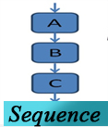
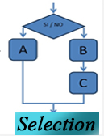
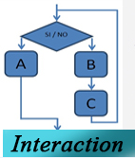
Structural Programming
Simple succession
of two or but
operations
Conditional
bifuraction of
An or but
operations
Repetition of an operation while a condition is completed

